Slide 1
Towards ASR for the Next Billion Users
Pratyush Kumar
Microsoft Research and AI4Bharat (IIT Madras)

Slide 2
Collaborators
This is joint work with various collaborators at AI4Bharat
Tahir Javed
Kaushal Bhogale
Abhigyan Raman
Gokul NC
Mitesh Khapra
Anoop Kunchukuttan

Slide 3
AI4Bharat (https://ai4bharat.org)
An IIT Madras initiative with support from
Government of India as part of Bhashini Project
Nilekani Philanthropies and EkStep Foundation
Microsoft
CDAC
Working in collaboration with many partners
Nvidia
Google Research

Slide 4
AI4Bharat (https://ai4bharat.org)
Mission
Bring parity with respect to English
in AI technologies for Indian languages
with open-source contributions in
datasets, models, and applications
and by enabling an innovation ecosystem

Slide 5
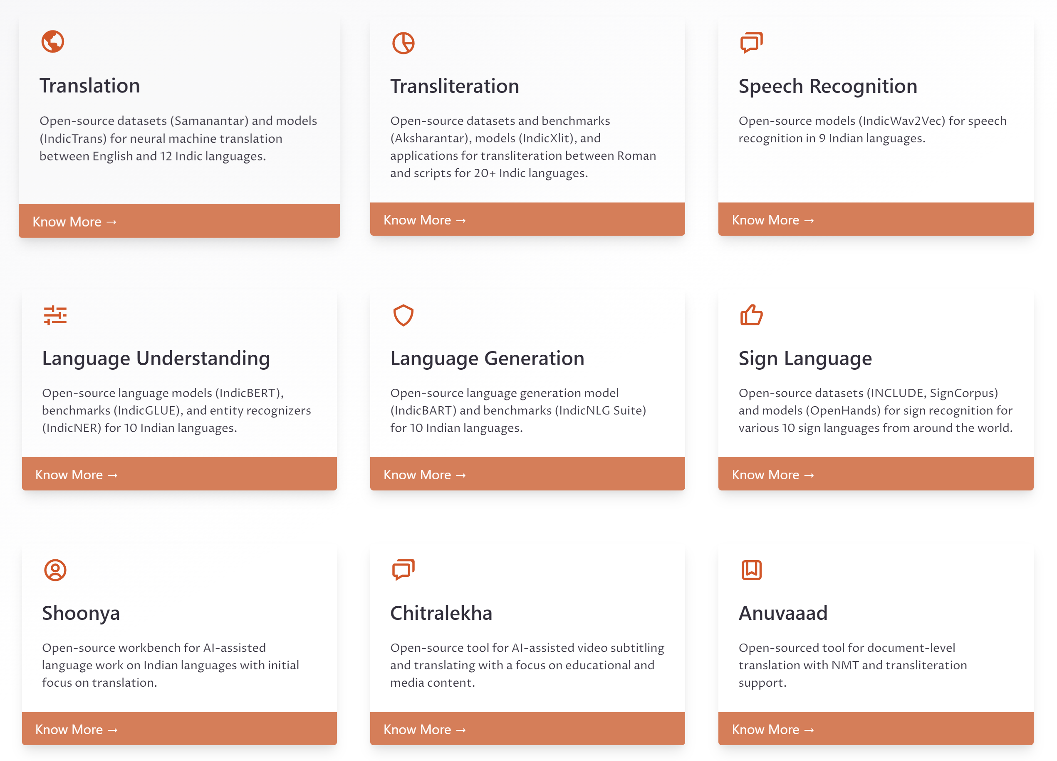

Slide 6
A Talk in Three Parts
The Trifecta: Data, Models, Apps
Our experiments with ASR: Dhwani, Shrutilipi, Kathbath
Applications

Slide 7
The Trifecta: Data, Models, Apps

Slide 8
The Trifecta
Data
Apps
Models

Slide 9
The Trifecta
Data
We all know that deep learning models require huge amounts of training data
Apps
Models

Slide 10
The Trifecta
Data
But not all data are equal – based on availability, quality, and cost
We all know that deep learning models require huge amounts of training data
Apps
Models

Slide 11
The Trifecta
Data
Improved models can also help create more data
Apps
Models

Slide 12
The Trifecta
Data
Accurate models enable greater use in real-world apps
Apps
Models

Slide 13
The Trifecta
Data
Applications help shape model development and iteration
Apps
Models

Slide 14
Our Experiments with ASR

Slide 15
Dhwani Dataset
“Self-supervised learning” for Indic ASR

Slide 16
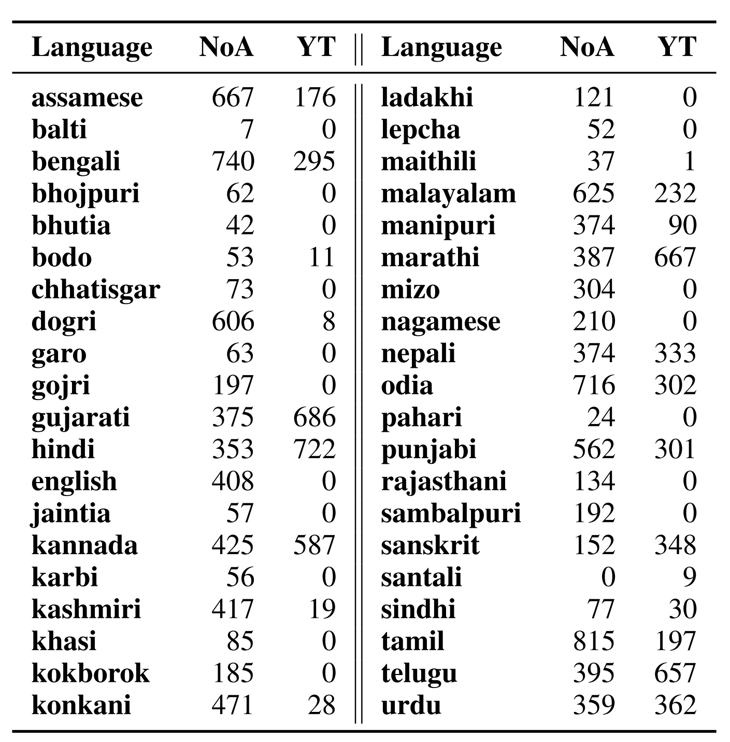
Dhwani Dataset
“Self-supervised learning” for Indic ASR
17,314 hours of raw audio from openly licensed content in 40 languages

Slide 17
Dhwani Dataset
“Self-supervised learning” for Indic ASR
17,314 hours of raw audio from openly licensed content in 40 languages
Contrast: Market rates for labelled ASR is about Rs 10,000 per hour (~USD 125)

Slide 18
Dhwani Dataset
Dhwani dataset
“Self-supervised learning” for Indic ASR
17,314 hours of raw audio from openly licensed content in 40 languages
Pre-train a ‘speech model’
Self-supervised learning
Multilingual wav2vec

Slide 19
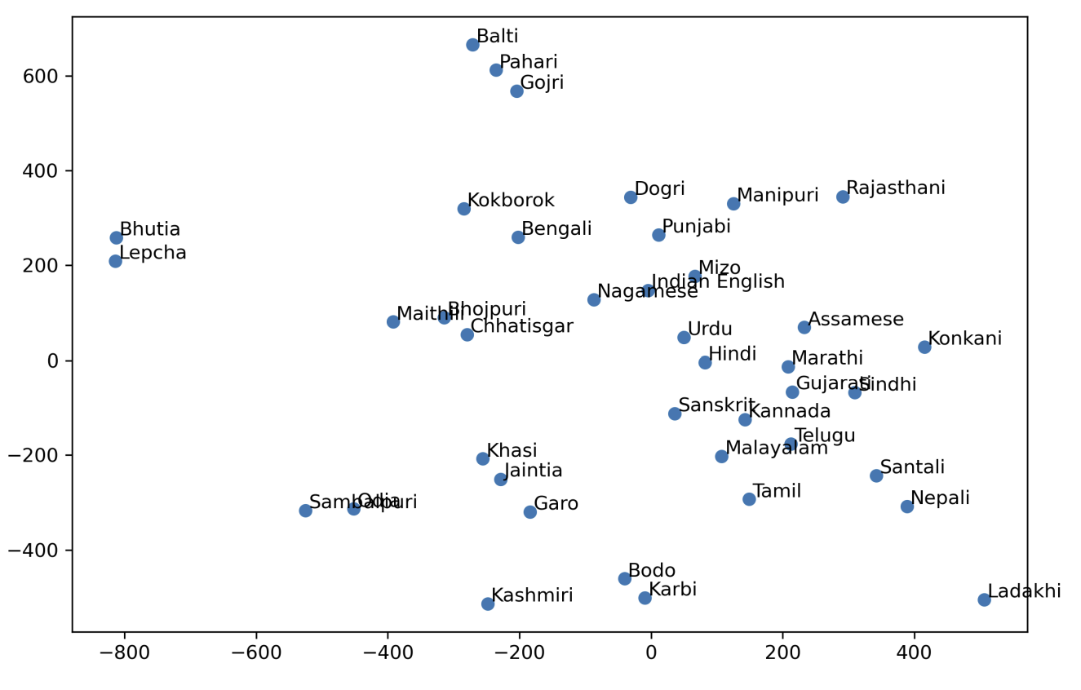
Dhwani Dataset
Dhwani dataset
“Self-supervised learning” for Indic ASR
17,314 hours of raw audio from openly licensed content in 40 languages
Pre-train a ‘speech model’
Self-supervised learning
Multilingual wav2vec

Slide 20
Dhwani Dataset
Dhwani dataset
“Self-supervised learning” for Indic ASR
17,314 hours of raw audio from openly licensed content in 40 languages
Pre-train a ‘speech model’
Fine-tune with smaller amounts of ASR data
Self-supervised learning
Multilingual wav2vec
Fine-tune on labelled data
Language 1 ASR model
Language 2 ASR model
…

Slide 21
Dhwani Dataset
Self-supervised learning or pretraining significantly improves accuracy on existing training/test sets

Slide 22
Shrutilipi Dataset
Self-supervised training helps, but we need more labelled data

Slide 23
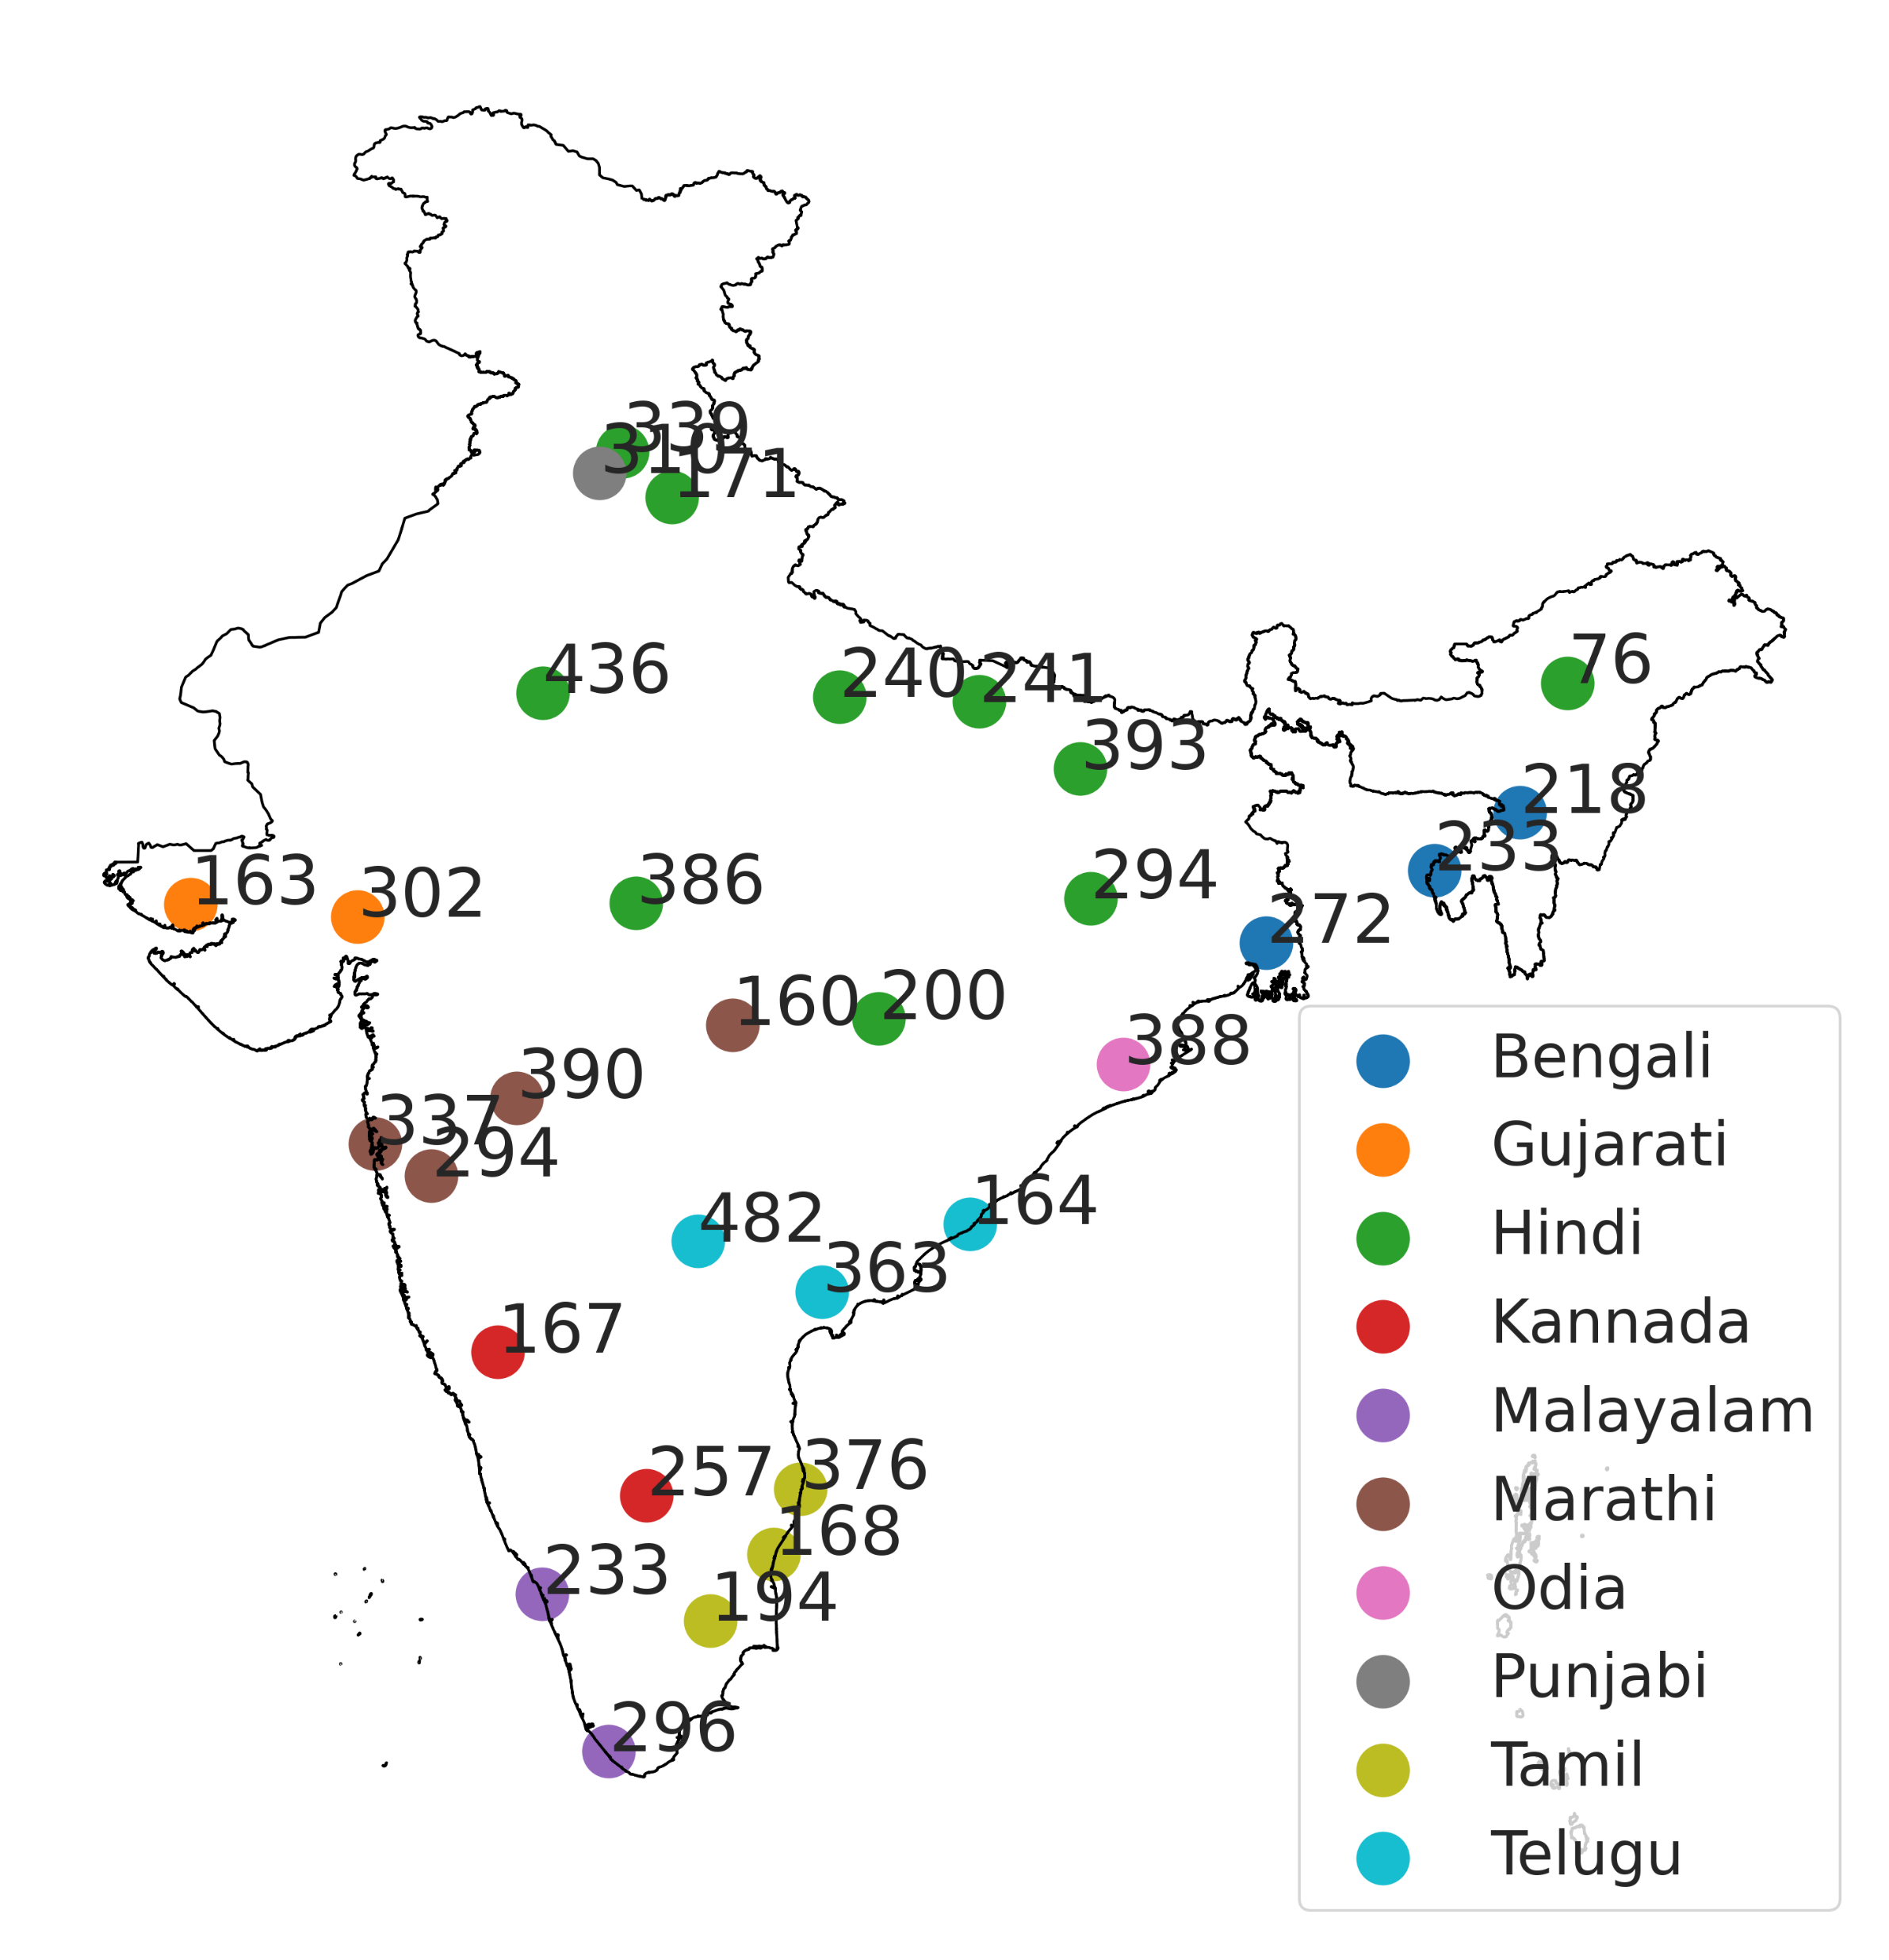
Shrutilipi Dataset
Number of hours of audio data from different radio stations
Data from All India Radio which is the public broadcaster in India

Slide 24
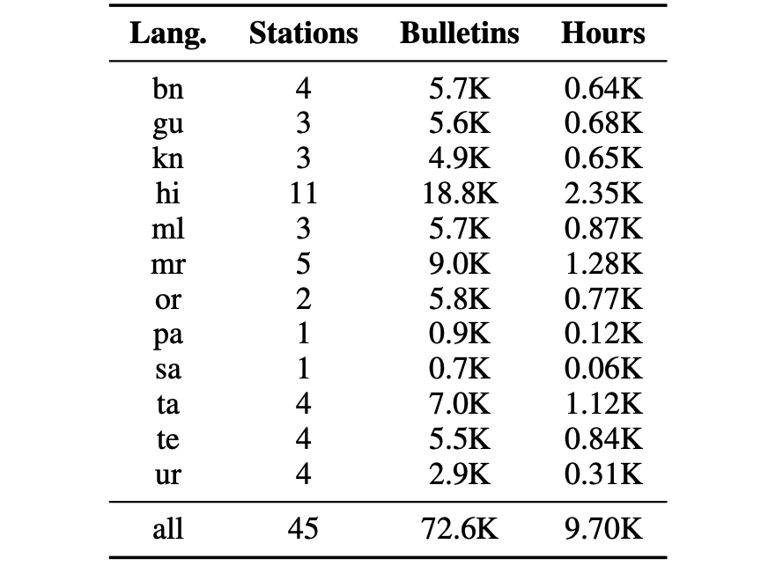
Shrutilipi Dataset
Number of hours of audio data from different radio stations
Data from All India Radio which is the public broadcaster in India
Covers many regional variants

Slide 25
Shrutilipi Dataset
Number of hours of audio data from different radio stations
Data from All India Radio which is the public broadcaster in India
Covers many regional variants
News is read out be a newsreader and transcript is also available in the public domain

Slide 26
Shrutilipi Dataset
Number of hours of audio data from different radio stations
Data from All India Radio which is the public broadcaster in India
Covers many regional variants
News is read out be a newsreader and transcript is also available in the public domain
Can we create labelled ASR data from audio + transcript?

Slide 27
Shrutilipi Dataset – Alignment Problem

Slide 28
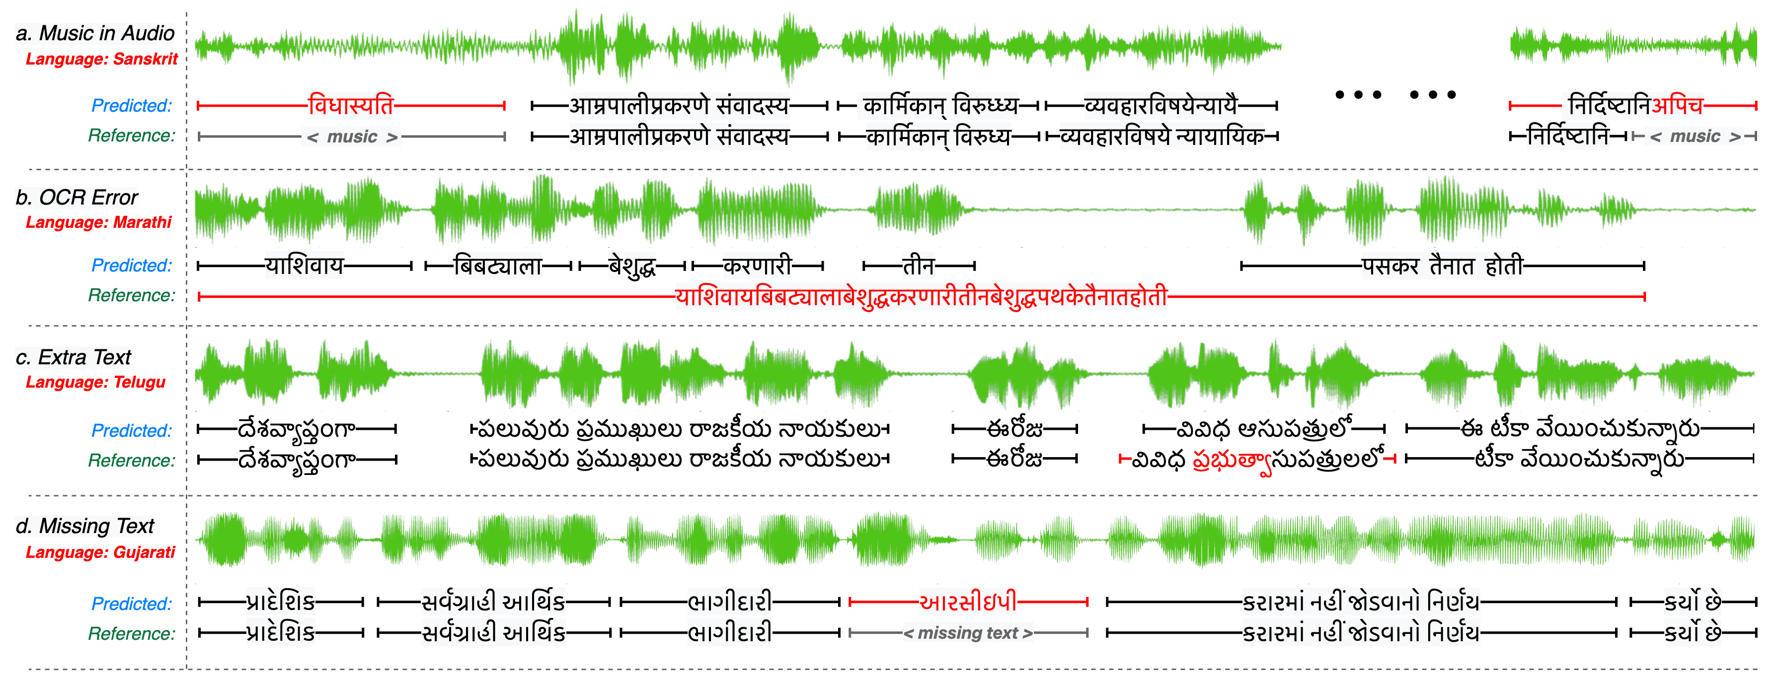
Shrutilipi Dataset – Alignment Problem

Slide 29
Shrutilipi Dataset – Alignment Problem
Transcript
Audio
OCR + heuristics
ASR + heuristics
Document-scale alignment

Slide 30
Document-scale Alignment

Slide 31
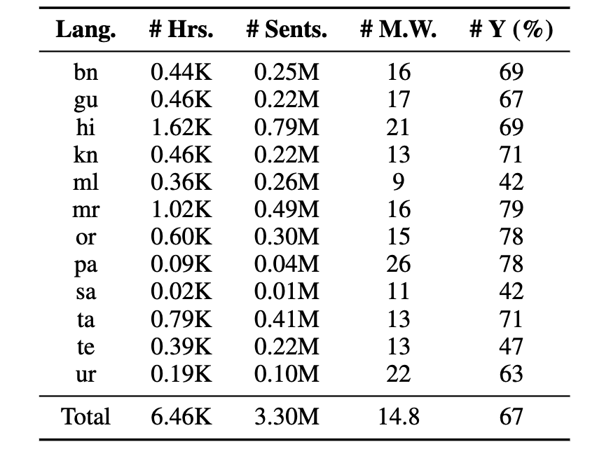
Shrutilipi Dataset

Slide 32
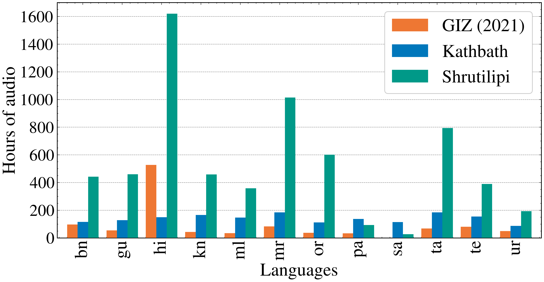
Shrutilipi Dataset

Slide 33
Shrutilipi Dataset

Slide 34
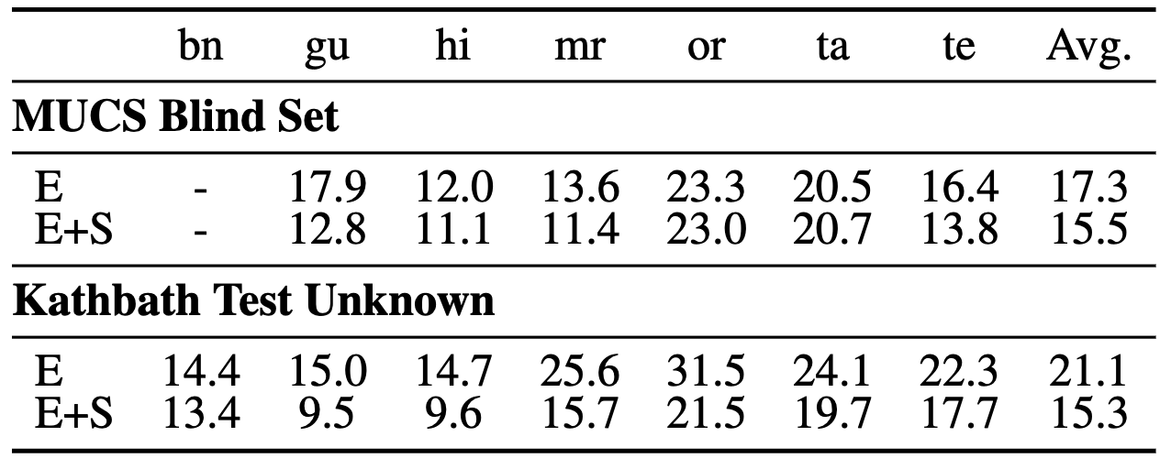
Shrutilipi Dataset

Slide 35
KathBath Dataset
Self-supervised learning helps, aligning labelled data helps, but we still need data collected manually from diverse locations

Slide 36
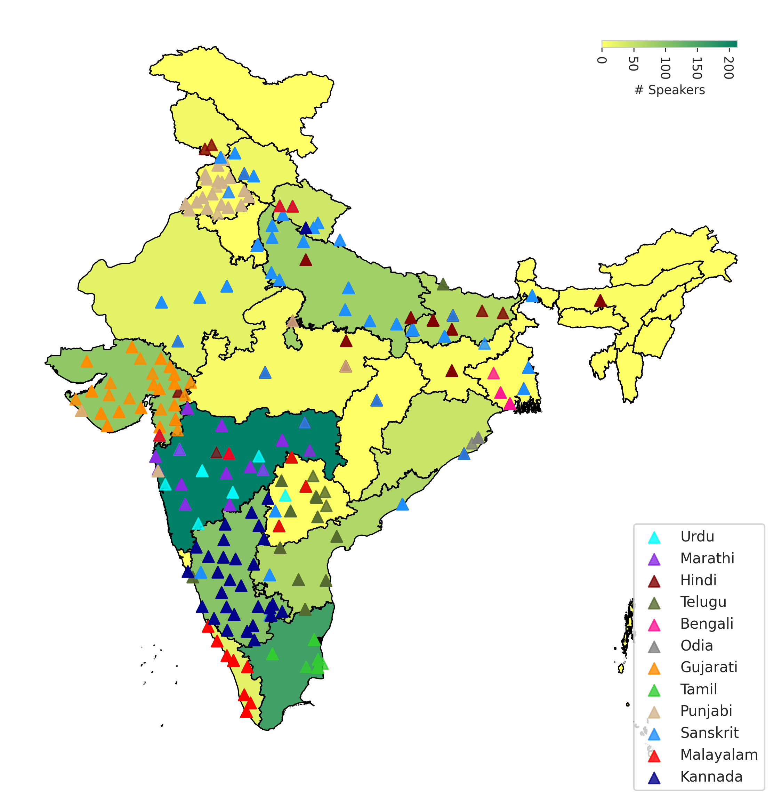
KathBath Dataset
We collected data using Karya app from Microsoft Research from 1,218 contributors across 203 districts in India

Slide 37
KathBath Dataset
We collected data using Karya app from Microsoft Research from 1,218 contributors across 203 districts in India

Slide 38
KathBath Dataset
KathBath dataset
1684 hours 12 languages

Slide 39
KathBath Dataset
IndicSUPERB Benchmark
ASR
Speaker recognition
KathBath dataset
1684 hours 12 languages
Speaker verification
Language identification
Query by example
Keyword spotting

Slide 40
Applications

Slide 41
Chitralekha tool for subtitling

Slide 42
Speaking custom ID alpha-numerals
Demo on https://asr-api.ai4bharat.org

Slide 43
Open-source
All datasets, models, applications shown here are open-source
You can access most of them at https://ai4bharat.org
If you don’t find something, please get in touch pratyush@ai4bharat.org
Thanks!

